Slide 1


VISVESVARAYA TECHNOLOGICAL UNIVERSITY BELAGAVI
MINI PROJECT PRESENTATION
ON
“EduNexa: Next Generation Education System BOT"
Presented by:
Anusha 3PG23CS025
Kanchana 3PG23CS043
Manasa 3PG23CS051
Megha 3PG23CS052
Under the Guidance of
Prof. Archana S
DEPARTMENT OF COMPUTER SCIENCE AND ENGINEERING
Ballari VV Sangha
PROUDHADEVARAYA INSTITUTE OF TECHNOLOGY
T.B DAM ROAD.HOSAΡΕΤΕ-583225
(Affiliated to VTU, Belagavi, Karnataka & Recognized by AICTE, New Delhi)

Slide 2
Contents:
1. Introduction
2. Literature survey
3. Objectives
4. Software requirements
5. Existing system
6. Proposed system
7. Results/Snapshots
8. Applications
9. Conclusion
10. Future scope
11. Bibliography

Slide 3
Introduction: A Smarter Campus Experience
A chatbot is an AI-based program capable of interacting with users through text.
Our project aims to create a smart, fast, and user-friendly chatbot for our college
It helps students get instant answers for academic and campus-related queries.
The system includes an Admin Dashboard to manage and update Q&A.

Slide 4
Literature Survey
Mehta, L. 2023 Conversational AI for next-gen learning platforms
Das, P. 2022 Natural language processing in educational chatbots
Nair, R. 2021 Machine-learning based chatbots for academic institutions
Verma, S 2020 Intelligent virtual assistants for student support
Iyer, K. 2020 Automated student query resolution systems
4 Kumar, A. 2019 AI-driven chatbot systems for modern education

Slide 5
Modern chatbots use NLP, machine learning, or manual
Database Q&A-based chatbots are simple, fast, and easy to maintain for college systems.
Several studies show students prefer quick automated answers over waiting for staff.
        Our chatbot adopts a simple but effective Q&A-based approach for accurate replies.

Slide 6
Objectives
To develop a chatbot that answers student queries instantly
To reduce manual workload for faculty and administrative staff.
To provide a simple admin interface for updating Q&A.
To enhance communication between students and the institution

Slide 7
Software Requirements /Hardware Requirements
Frontend: HTML, CSS, JavaScript
Backend: Python
Frameworks: Flask
Database: MySQL
Tools: Browser/VS code

Slide 8
Existing System
Students depend on staff for basic information.
Manual communication leads to delays and repeated
No centralized platform for answering common queries.
Information is scattered across websites, notice boards, and departments.

Slide 9

Proposed System
A centralized chatbot system designed to answer student queries 24/7
Interactive text-based interface that allows students to chat easily.
Responds instantly using the predefined Q&A database stored in the backend.
Ensures consistent and accurate information every time.
Working Demo
User queries chatbot
Chatbot responds instantly
Admin logs in
Admin updates Q&A

Slide 10
Admin Module
Secure Admin Login ensures only authorized staff can modify data.
Admin can Add, Edit, or Delete Q&A pairs as needed
Updated information is reflected immediately in the chatbot responses.

Slide 11
Features
Simple and clean Ul for both students and admin, ensuring smooth usage.
Provides instant and accurate responses, improving communication.
Q&A database is fully customizable, allowing colleges to update information anytime.
Works as a reliable always available digital assistant for students.

Slide 12
Results
Chatbot interface allows students to type queries easily.
Displays conversation flow with sample dialogue such as:
User: hello
Chatbot: hi, how can I help you?
Clean layout makes the chat experience simple and engaging

Slide 13
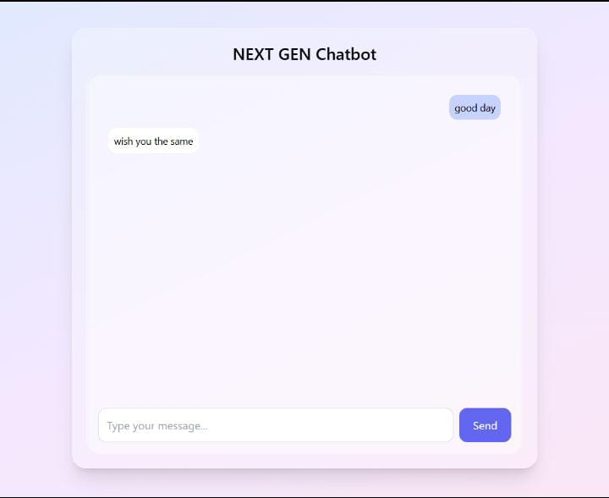
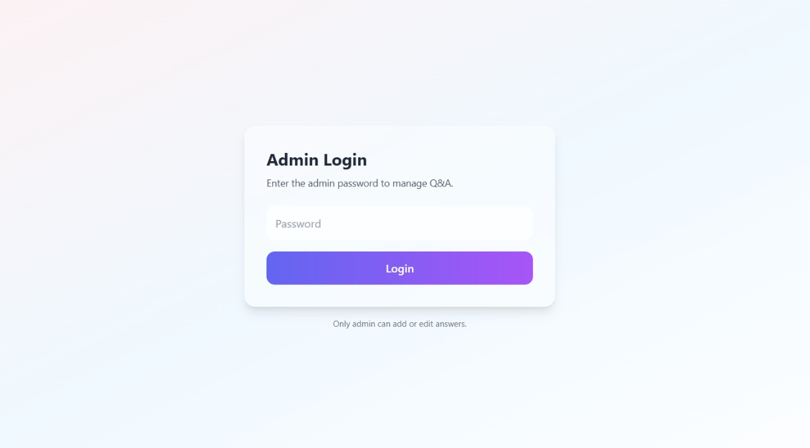
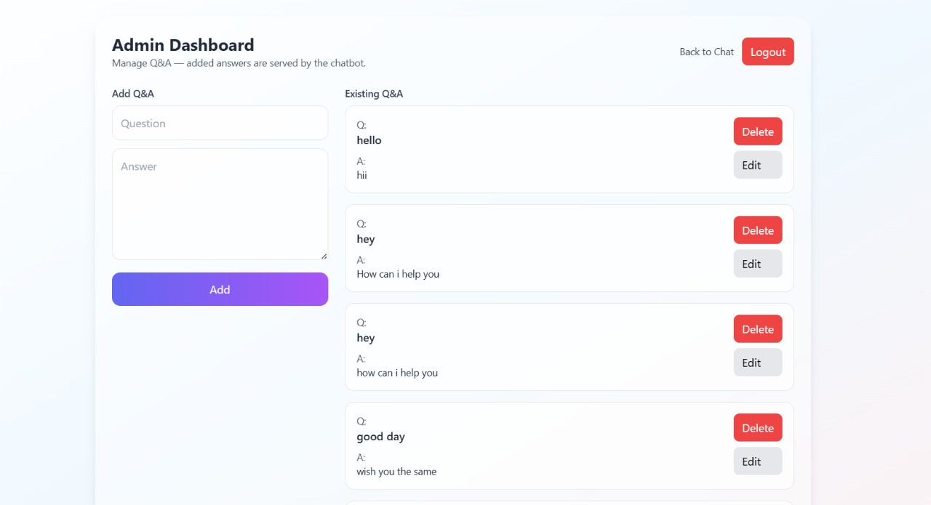
Snapshots

Slide 14
Admin Login Page
Shows secure password-based login for admin access.
Ensures that only authorized personnel can manage the Q&A database.
Interface is minimal and user-friendly for quick login.

Slide 15
Admin Dashboard
Admin can add, edit, and delete Q&A.
Updated data reflects instantly in chatbot.
Simple interface for easy management.

Slide 16
Applications
Student support for college information
Admission help desk
Hostel & fee-related FAQ
Department inquiry
. General FAQ automation

Slide 17
Conclusion
The chatbot reduces manual effort and improves communication.
Easy-to-use admin module makes updating information simple.
Provides fast, reliable, and 24/7 support for students.
A scalable project that can grow with future requirements.

Slide 18
Future Scope
Integrate Al/NLP for smarter responses
Add voice-based chatbot support
Connect to college ERP systems
Add multi-language support

Slide 19
Reference
1. Kumar, S., & Sharma, R. (2022). Artificial Intelligence in Education: Applications and Future Trends. Springer Publications.
2. Chopra, A. (2021). Natural Language Processing with Python. O'Reilly Media.
3. Jain, M., & Verma, P. (2020). "Chatbot Architecture and Design for Educational Institutions." International Journal of Computer Science and Engineering, 8(4), 112-119.
4. Google Cloud. (2023). Dialogflow Documentation. Retrieved from Google Developers.

Slide 20
Thank you

